Slide 1
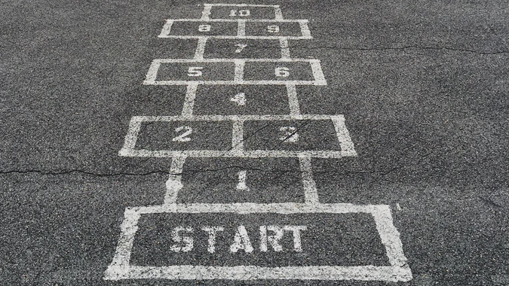
Learning + teaching about data + data tools in physical behaviour research
All photos from Unsplash

Slide 2
Scenario 1: Training workshop for physical behaviour researchers in using particular data/software/ method

Slide 3
Scenario 1: Training workshop for physical behaviour researchers in using particular data/software/ method
Designing a session:
Aims
Understanding/ technical competence
Theory/ practice
Designing a practical assignment
Presenting
Working together/separately
Practical factors:
Data
Devices
Software
Materials
Barriers and overcoming them:
Technical confidence
Different levels of experience
Doing it virtually

Slide 4
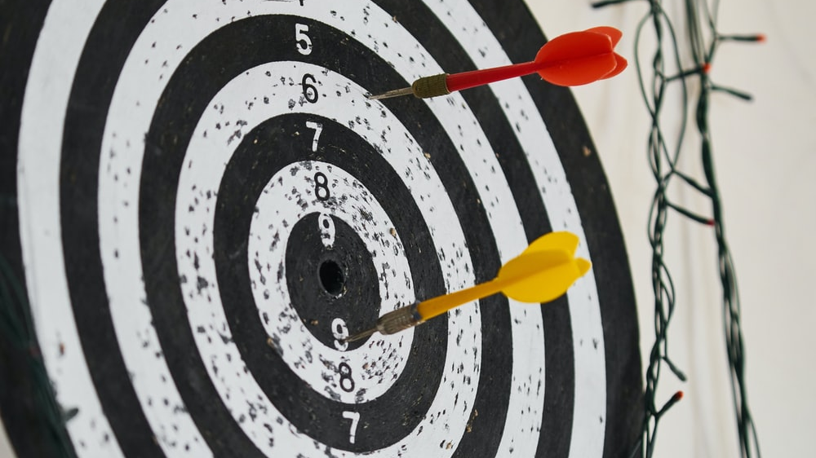

Slide 5
Aims
What sort of aims are most successful? Specific? Generic?
Group aims vs aims of individuals
Examples: understanding what the software can do; being an independent user of the software; gaining some particular competencies
Highly dependent on who the audience is and how big (PH)
Larger audience more difficult (PH) – fewer than 5 = very easy to tailor to needs
Individual goals which work well together (PH) e.g. learning from people a few steps ahead
Size as a limiting factor (PH)
Workshop on giving virtual workshops – motivations people might have to learn. (HM)
Above about 4 or 5 for a group discussion, hard to draw everyone in. (HM)
Type of audience really matters. Really involved vs quite passive (and afterwards emails!) Actively drawing people in, know what aim is and able to ask questions (VvH)
Comfortable speaking in English? (VvH)
Technical stuff out the way as quickly as possible, or offer in cloud format (JM)
Advantage of remote stuff- questions which are chat based or text based (JM)
Litmus test- walk around/ stand somewhere long enough to get questions (JM)
Useful to have a coleader monitoring channels and side questions (HM) Also comfortable to interject!
Texting questions (PH) anonymity

Slide 6
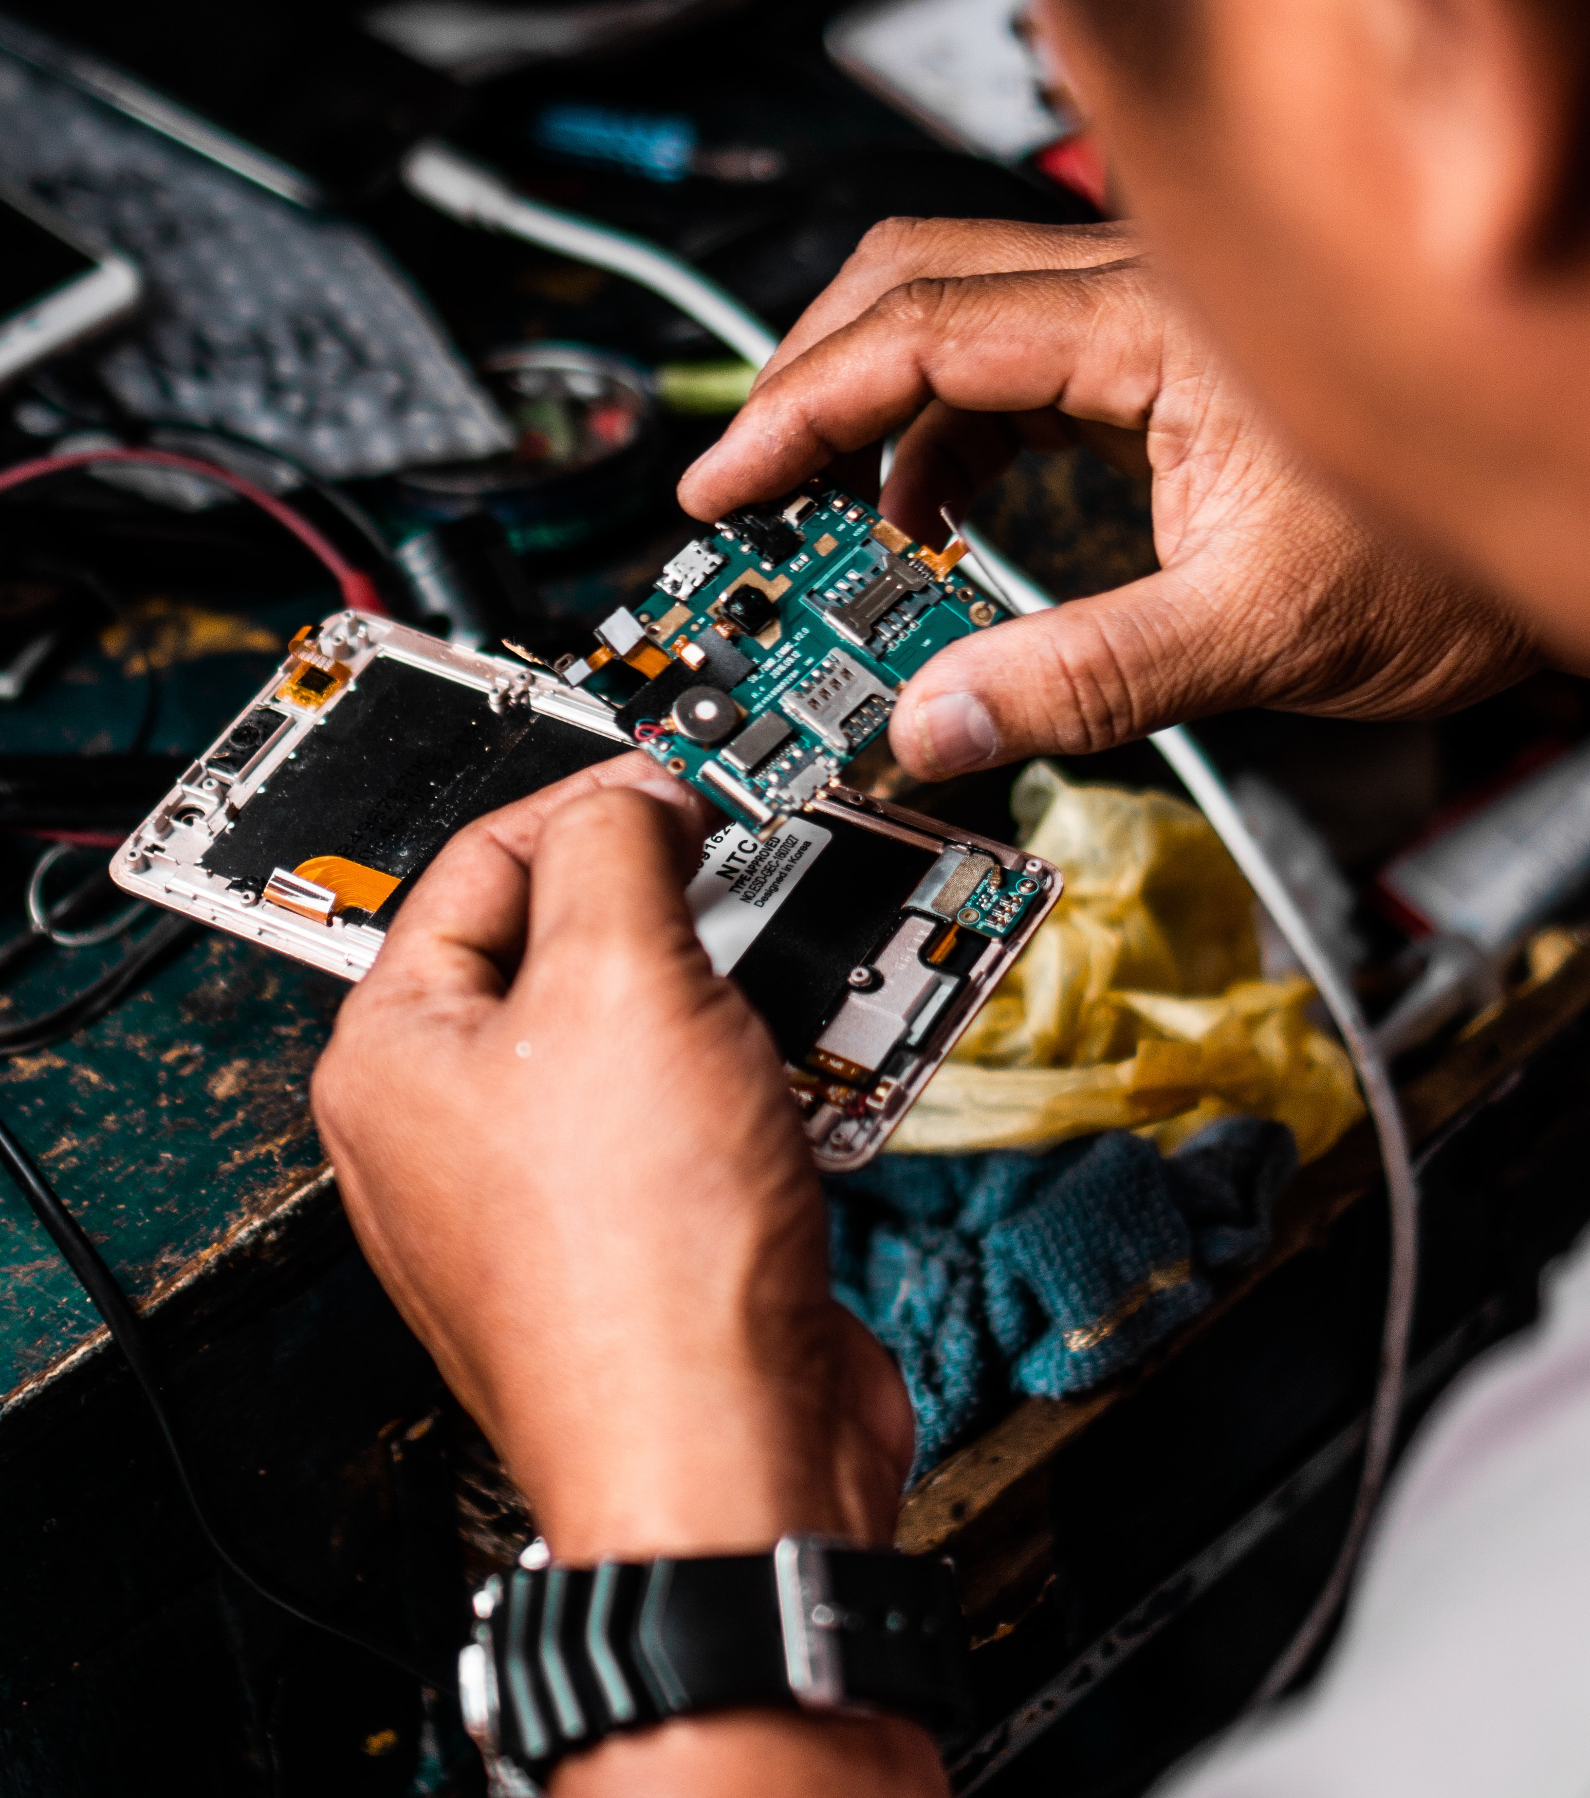
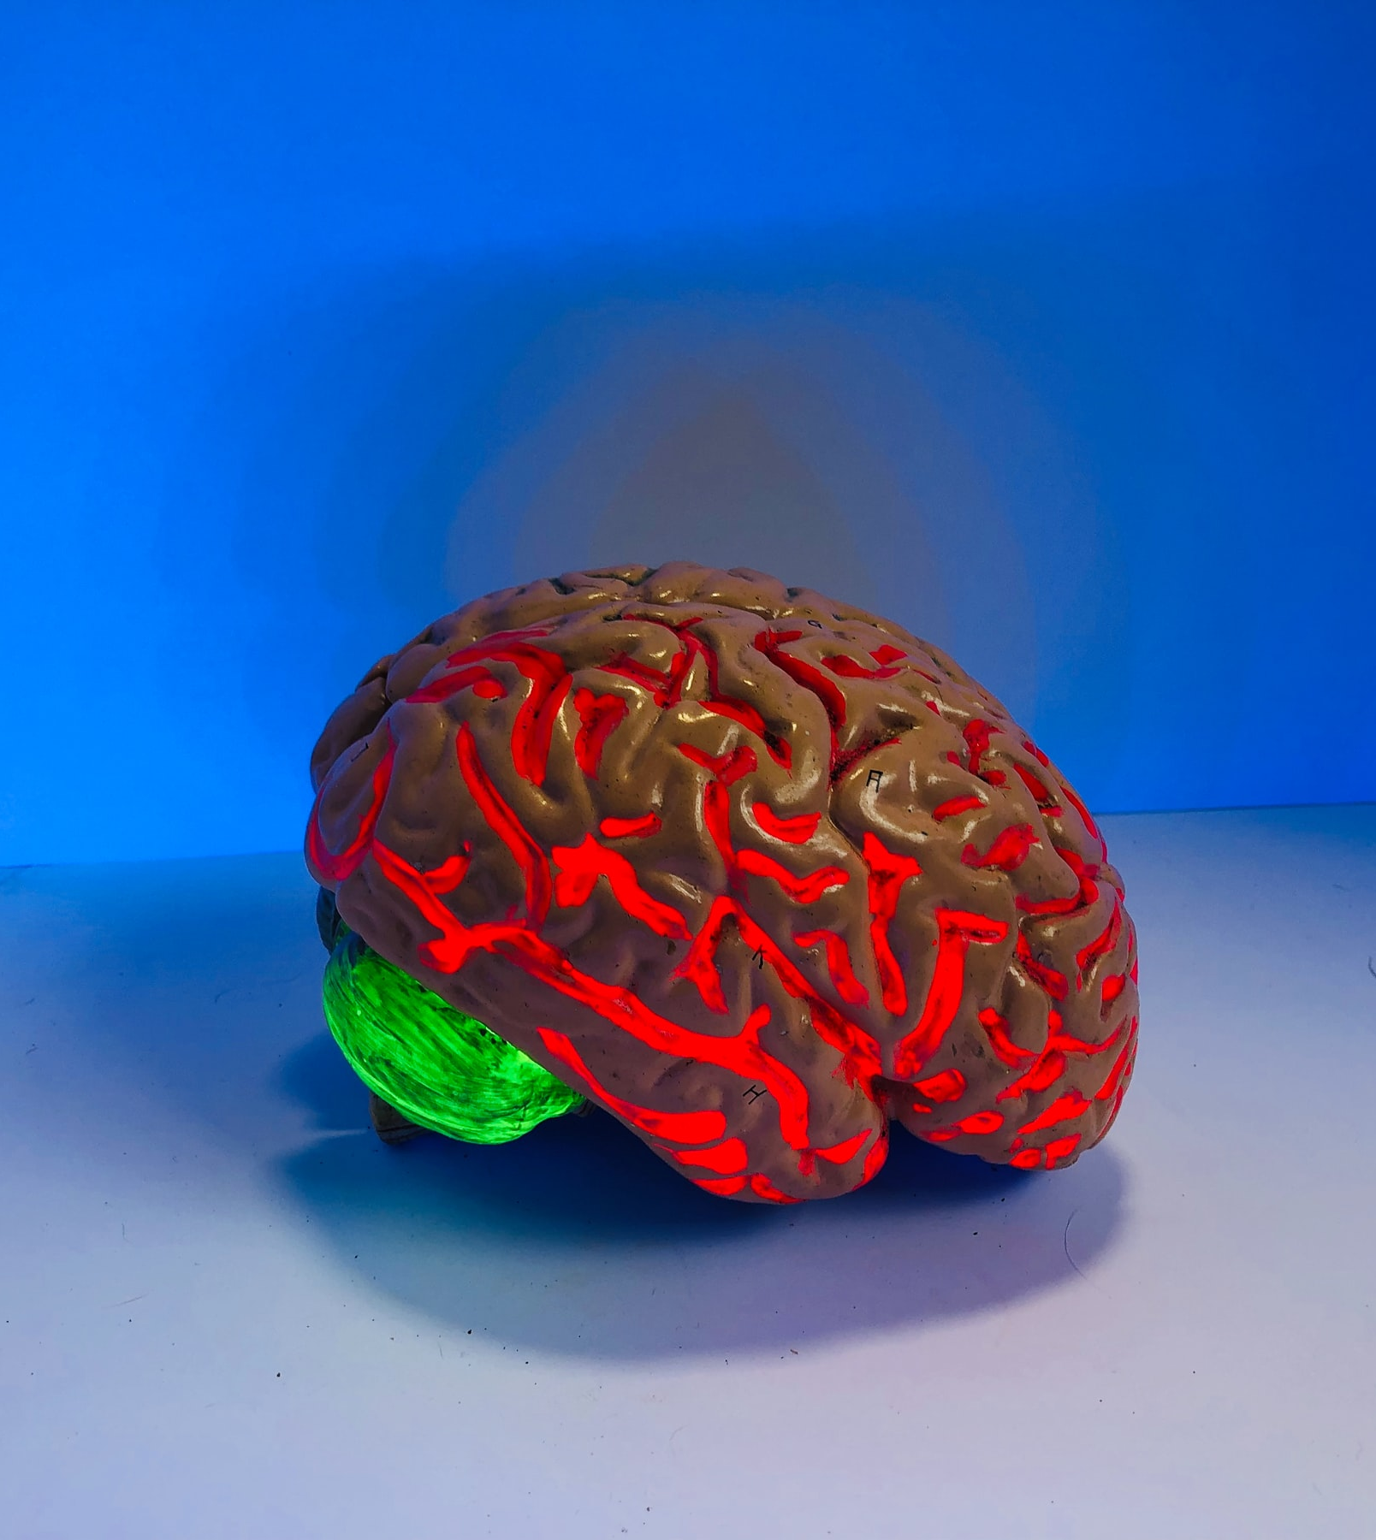

Slide 7
Technical competence vs understanding
Is one necessary for the other?
Will one lead to the other?
Do they come in a natural order?
Limited time to train people: things in the data processing which are more directly relevant for the science than the other parts and focus on what’s important for the science. For other things like device calibration which are further from the scientific decisions, go with defaults. Examples of things relevant for science: thresholds, bouts (or not), range of variables available beyond time spent in bouts. Make critical about what the data is and the measures are (VvH)
Language – e.g. missing data – different meaning in different disciplines (HM) things which trip you up initially based on background. Questions about different terms. Potential barrier that it can be embarrassing to ask these questions?
Increasingly big problem (PH)
‘Biggest bang for your buck’ (following VvH’s point above)– know your group. (PH)
Entry level R user – what can you do in the time? What will best position them to go on and continue learning? (PH)
make new users aware of R resources e.g. RCore community e.g. Hadley Wickham books (PH)
(SS) end of session – ask questions which haven’t dealt with. How do you find solutions to these problems? Then a better understanding of how to deal with those problems when they come up independently. Spending some time problem solving. Last 10 minutes of 60 minute python session – questions from easy to difficult and had 10 minutes to find solution online – chopping problems into small pieces.

Slide 8
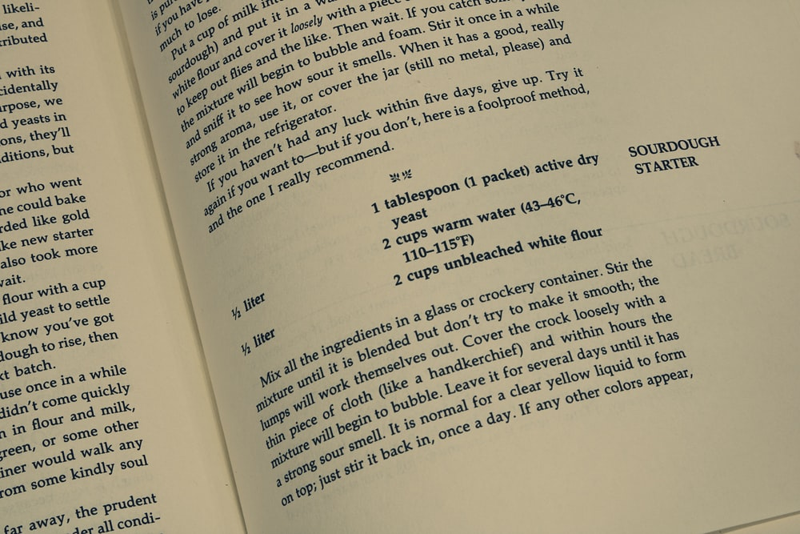
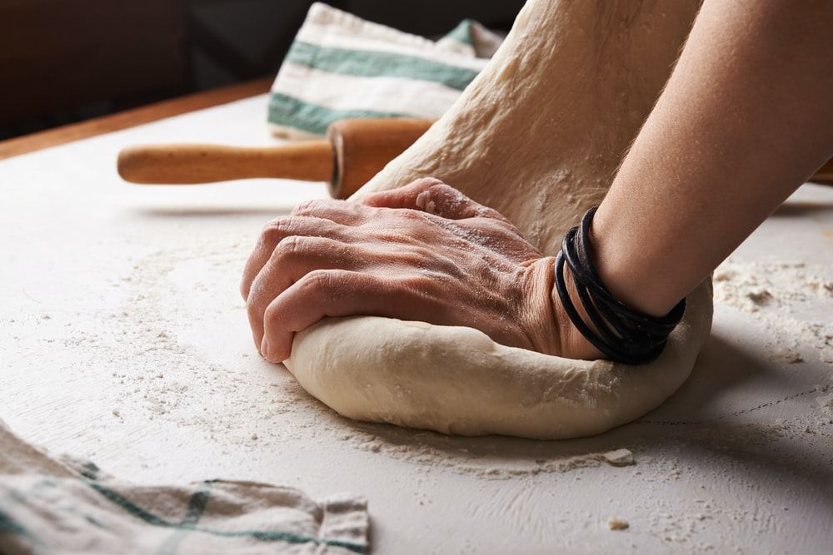

Slide 9
Theory vs practice
How important is incorporating a practical component?
Where should it fit? Throughout? After some theory? Before theory?
Works best to start with some theory, short demo, tell them to do it at home after session. Second session to review. Lots of little things to go wrong. Trying to do more things outside the workshop. (VvH)
Very relevant especially for online (PJC) Tell the difference between: the usual format vs provide info (e.g. morning)- then session to work on using it – then returning in an afternoon session. Means people can work in own schedule.

Slide 10
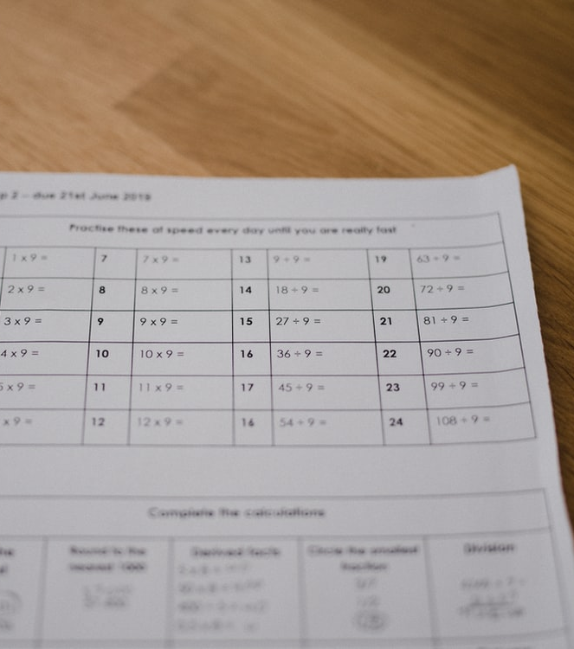


Slide 11
Designing a practical assignment
Good designs for a practical assignment: ‘process this data with the software + try to understand the output’; ‘process this example dataset + answer these research questions about data quality’ …
How much guidance (or ‘scaffolding’)? e.g. pre-prepared code with some parts to fill in vs task with little detail
Real-world examples with messy data? Toy, clean examples which communicate the key idea?
People try to do everything: bring own data in + all the analysis – as the data can be different this can be very difficult e.g. csv file with spaces vs tabs etc . Nice for a longer class. Let students interested come back and ask those question. Vote towards processed data in short sessions. (HM)
there are also advantages to struggling through it - e.g. installing R, as people do have to do this with their own data (VvH)
Has to be really relevant to them- see what they get out of it. Bringing in own data -> relevant to what doing. (TS)
Sometimes data can be too simple to get across. Sometimes you need other data to illustrate that (TS)
Class on data visualisation – not part of the assignment, but there were a couple of other things in the data which were pointed out at the end (HM) made more engaged with future data. ‘There’s a bit more than what I’d thought about.’
Visualising is an important part of any practical assignment (TS)
(PH) sometimes this is hard to do!
Coding up some helper functions + some visualisations which aren’t the main point but still take a long time but help along the way. (SS)
Exposure to basic step of calling a function (PH)
Workshop + assignment working together – workshop = show people what is possible in language you’re using. Pique curiosity etc. Assignment attainable off the bat. See the bridge from this assignment to other things ‘Here are the things that you need to be able to do which you can’t do in point and click and here’s the first step’. (PH)

Slide 12


Slide 13
Presenting
Traditional lecturing/ presenting vs other styles
Continuous or interspersed with practical
Prepared examples vs live coding

Slide 14



Slide 15
Working together/ independently
Pros and cons of working together/ independently

Slide 16




Slide 17
Data, devices and software
Good datasets to use? Openly available? Own data?
Devices
Using the cloud? (e.g. RStudio Cloud)
(SS) May be too heavy but Docker – everything pre-installed and you can use that.
(JM) Some things which it seems it would be nice to do easily in Docker but can’t be done e.g. visualising versions without having to do it from the command line (to make it easier for non-expert users). Avoiding ‘Version Hell’
(SS) especially important if making use of external tools. Very specific versions of packages. Some students managing it, others not etc.
If working in a particular lab useful as same software on every system etc. (HM)
Linux, mac, PCs. (HM)
(VvH) Rstudio Cloud free- 2Gb~ memory. Bit limited – think about what put in there. Commercial version. Online interface to RStudio.
Interesting to consider how light data is (PH) lighter you can keep it. Not wasting time waiting for commands to run (PH)
(SS) Google colab
Datasets: examples of data which isn’t very good. E.g. poor compliance, sensor errors etc. (TS)
(PH) especially important because these are the things which are really hard to automate
(HM) for matlab you can use https://matlab.mathworks.com/

Slide 18

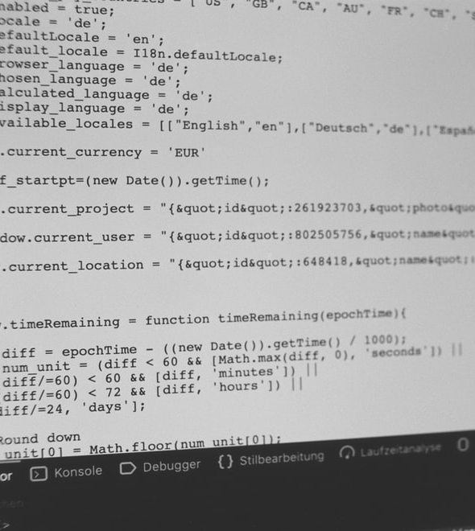

Slide 19
Resources
Are there any good open teaching materials for sessions around physical behaviour measurement/ accelerometry?
Share additional thoughts on issue (VvH)
Which are the landmark papers in the field (VvH) useful resource to compile. Papers usually aren’t educational in nature though – not written for that audience.
(PH) currently working on open data repository and processing to improve communication across disciplines. Once repo active /in review share.
(JM) https://johnmuschelli.com/upper_limb_gt3x_prosthesis/
(CM) The Objective Monitoring of Physical Activity: Contributions of Accelerometry to Epidemiology, Exercise Science and Rehabilitation (Editors: Roy J. Shephard, Catrine Tudor-Locke) General info. Usually useful to people new to the area.

Slide 20



Slide 21
Overcoming barriers
What are common barriers to sessions like this going well for participants?
How do you approach lack of technical confidence in participants?
How to do you approach a session where there are very varied skill levels and prior experience?

Slide 22


Slide 23
Doing it virtually
How much of what we’ve discussed transfers well to virtual workshops?
Are there any particular things to be aware of in virtual workshop?

Slide 24

Barriers and overcoming them
What are common barriers and how do you address them?

Slide 25
Further thoughts?

Slide 26
Scenario 2: Training an individual in the pipeline of analysis of physical behaviour data

Slide 27
Scenario 2: Training an individual in the pipeline of analysis of physical behaviour data
Design:
Aims
Priorities
Theory/ practice
Good practice
Practical factors
Barriers and overcoming them

Slide 29
Aims
How can you set aims? How can you break down overall aims into a learning process?

Slide 30


Slide 31
Priorities
Learning specific things about accelerometer data vs learning general software and data skills (e.g. programming languages, Git and GitHub)?

Slide 33
Theory vs practice
Where should it fit? Throughout? After some theory? Before theory?

Slide 34
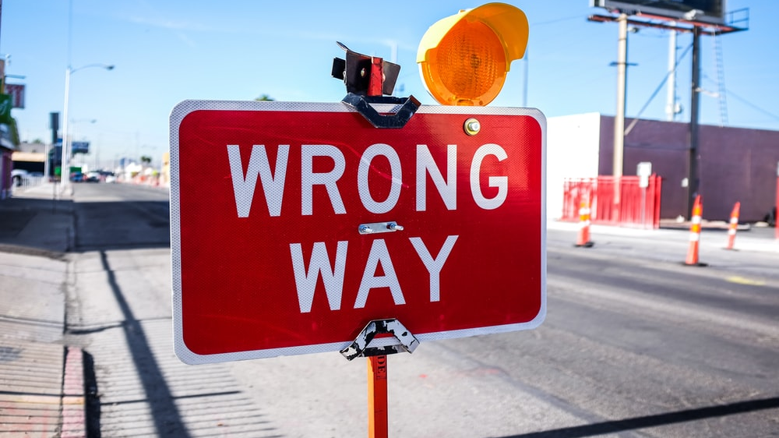

Slide 35
Good practice
‘Anything that works’ or adhering to particular principles

Slide 36


Slide 37
Practical matters

Slide 38
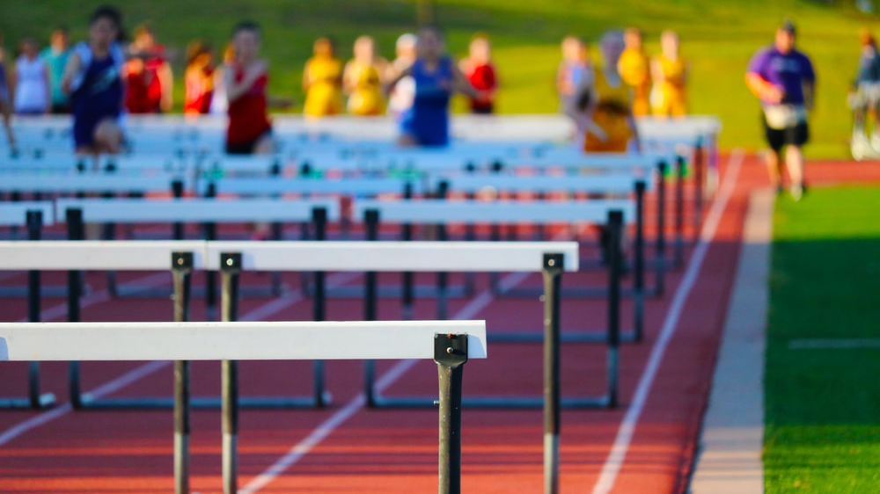

Slide 39
Barriers and overcoming them
What are common barriers and how do you address them?

Slide 40
Barriers and overcoming them
What are common barriers and how do you address them?

Slide 41
Further thoughts?

Slide 42
Thank you!
Give me feedback on how the session worked!
rosemary.walmsley@gtc.ox.ac.uk
@R_Walms

